Slide 1
Beginner Machine Learning w/ R and/or Azure
How many crimes will be committed in Denver tomorrow?
Notes:
INTRO - NOT AN EXPERT
I’ve done a few of these before, and the ones that have been lame are the ones where I was an expert; however, i’ve always received excellent feedback when it’s a subject I’m newer to and excited about... So I don’t claim to be a guru in ML, Azure or R... so let’s dive in.
SIDE GIG, LEARNING SEXY I work a side-hustle for an ML company SalesTemp/PatientForecaster, but I have been working on all the ‘unsexy’ parts.. So I have been attempting to learn the exciting part of the business over the last month...

Slide 2
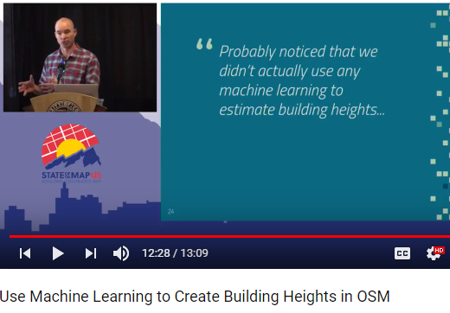
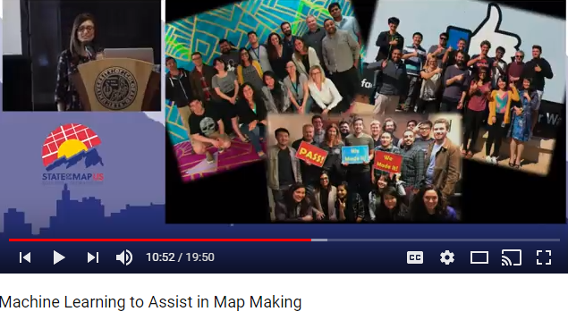
Most Data Science is presented as so hard it’s unusable w/o a huge team of PHDs
Notes:
Slides from OSM State of the Map.. Notice the title and the last slide..of the first one... The second one is mostly Facebook engineers... at least 50 people.

Slide 3
I Disagree
Anyone with basic technical skills, can do basic ML in a weekend.

Slide 4
Machine Learning Steps
Ask the Right Question
Prepare the Data
Select the Algorithm
Training the Model
Test the model.
Repeat over and over.

Slide 5
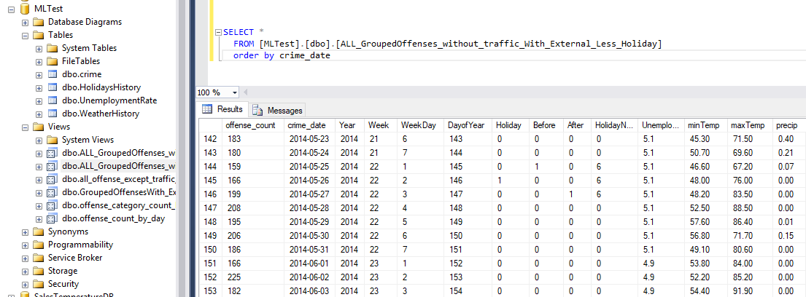
Data Prep
Usually 50-80% of the Time/Effort. Everyone underestimates the effort required for this step.
Notes:
3 PROCESSES Realistically you will need 3 different data processes.. History, Updates, Forecast.
NEVER FORMATTED / INDIVIDUAL CRIMES/ GROUPING Data is never in the format you need.. I was able to utilize some of the data I had already molded for those projects. The Crime data was by individual crime.. So I had to do a lot of grouping. Also I talked to subject matter experts that confirmed my suspicion that Crime would go up w/ Temp, but Accidents would be inverse, so I would need to split those.
HOW I did all of my prep in a local SqlServer, so I could use for both R and Azure - however both systems have many data prep tools.

Slide 6
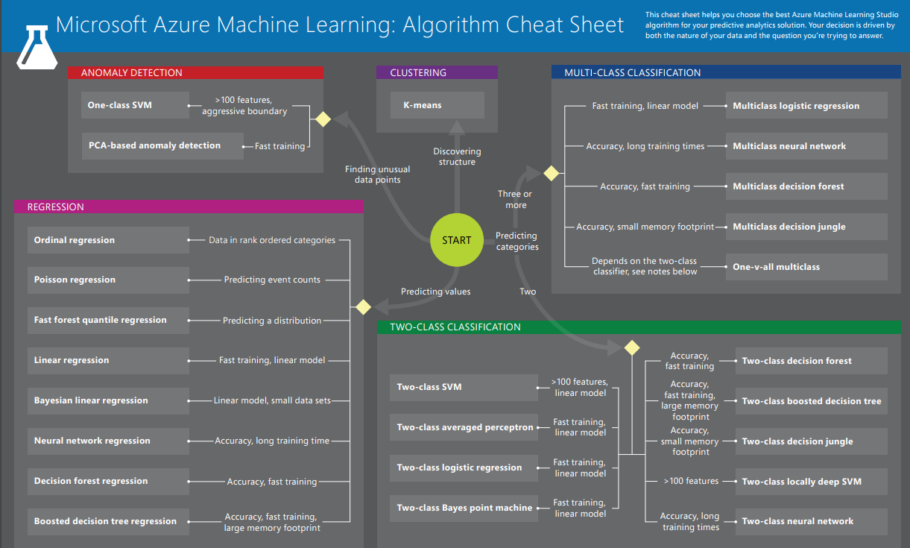
Data Split / Select Algorithm / Train
Normal is around 70% Training Data / 30% Test Data.
You must split your data, or you will by definition overstate your accuracy if you use your Test data for training. 4 Primary Algorithm Types Anomaly Detection Classification (2 Class / MultiClass) Clustering Regression
Link to Algorithm Cheat Sheet on last slide->
Notes:
You can NOT use test data in training, or by definition you will overstate your accuracy.

Slide 7
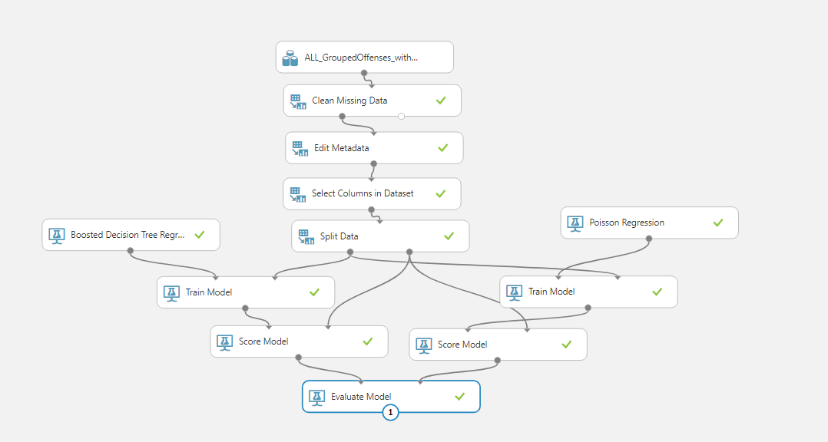
Notes:
Walk through Steps ... Drag and Drop.. Very Similar to SSIS if you’ve used that.
Define ‘Label Column’/ Train Column..
Split Data
Score allows you to evaluate data
Evaluate Model shows results
Includes integrated WebService to get future predictions based on Model Results.

Slide 8
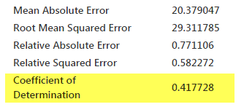
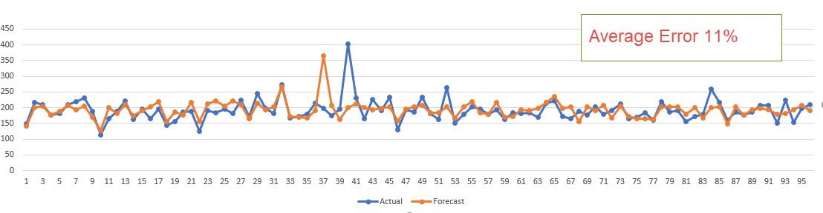
Evaluation of Model
Notes:
Coefficient of Determination is Rsquared.. The standard starting point.
How close the data is to a fitted Regression Line. 0 = Randomness (I believe based on the average) 1 = Perfect correlation.

Slide 9
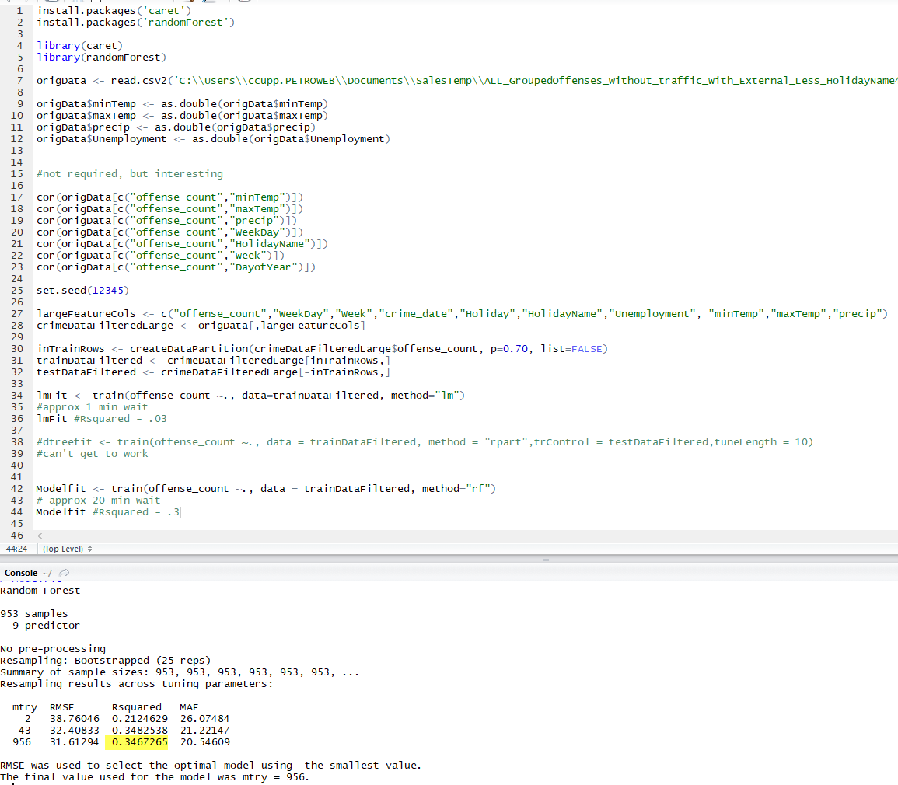
R
Notes:
WIDE ADOPTION/ BUT DIFFERENT TUTORIALS
LIBRARIES
ARCGIS and AZURE
R has wide adoption, but I found the documentation confusing. It is simple and straightforward in many ways. Like many languages these days it relies very heavily on 3rd Party Libraries (like caret)
R is THE Standard. But I used Classification tutorials and tried to convert them to my linear needs.. Perhaps if I’d started w/ a linear tutorial.ArcGIS and Azure both offer options to pull in R scripts.
UCDenver’s GIS Analysis Class does use R, and several ML companies that I have spoken with use R.

Slide 10
Now what.
More Data.... Always more Data.
More History
Other Sources
Student Schedule
Events (Broncos, Rockies Games, Concerts, Raves)
Realistic Scenario.. This would be a far superior/usable model if it was by precinct or neighborhood... and you would need GIS Skills.
Notes:
NEIGHBORHOOD
GIS
MILE HIGH
Looked at Data and noticed a spike on one day from a single address... Mile High Stadium.
IN THE REAL WORLD , you would want to do this by neighborhood/precinct...
And to do that you must use GIS. The ML folks won’t know how to ask..
-Which zip or airport do I use to get weather.
-Which zips are affected most by Events..
Use R inside your ArcGIS project.

Slide 11
Can be done w/ Pythons
Using NumPy and Pandas

Slide 12


Links
https://github.com/gcaseycupp/MLwithRandAzure gcaseycupp@gmail.com
SalesTemperature: http://www.salestemperature.com/ ForecastER: http://www.patientforecaster.com/ Pluralsight - Azure ML: https://app.pluralsight.com/library/courses/azure-machine-learning-getting-started
Pluralsight - R: https://app.pluralsight.com/library/courses/r-understanding-machine-learning
Azure Algorithm Cheat Sheet: https://docs.microsoft.com/en-us/azure/machine-learning/studio/algorithm-cheat-sheet
Denver Crime Stats Home : https://www.denvergov.org/content/denvergov/en/police-department/crime-information/crime-statistics-maps/2015-crime-statistics-maps.html

Slide 13
More Links
Denver MileHigh MapTime Meetup : R Intro: https://github.com/rsteve388/Maptime-Introduction-to-R-/
Which Algorithm: https://blog.statsbot.co/machine-learning-algorithms-183cc73197c
Getting Data Science with R and ArcGIS: https://community.esri.com/videos/3269 ML with ArcGIS / R Bridge :: https://community.esri.com/videos/3343 https://learn.arcgis.com/en/projects/analyze-crime-using-statistics-and-the-r-arcgis-bridge/lessons/install-the-r-arcgis-bridge-and-start-statistical-analysis.htm
Intro to Machine Learning ; Udacity - Free - Python https://www.udacity.com/course/intro-to-machine-learning--ud120 Youtube Siraj Raval https://www.youtube.com/channel/UCWN3xxRkmTPmbKwht9FuE5A
DataScience w/ Python: https://docs.google.com/presentation/d/17UwfhctUTE1zKsBrHdMg43kybef9GtTOaNv2rf8Y4yo/edit#slide=id.g1f904a824b_0_232

